Slide 1
Activity Diagrams
Programming – Code Design & Data Structures

Slide 2
Contents
What Are Activity Diagrams
Activity Diagram Basics
Concurrent Activities
Swimlanes
When to Use Activity Diagrams

Slide 3
What Are Activity Diagrams
Depicts the dynamic behaviour of a system
Shows the flow of control between the actions the system performs
Very similar to a flow chart
The exception being that activity diagrams can show concurrent processes
Shows the work flow from a start point to a finish point, detailing all the decision paths that exist between those two points

Slide 4
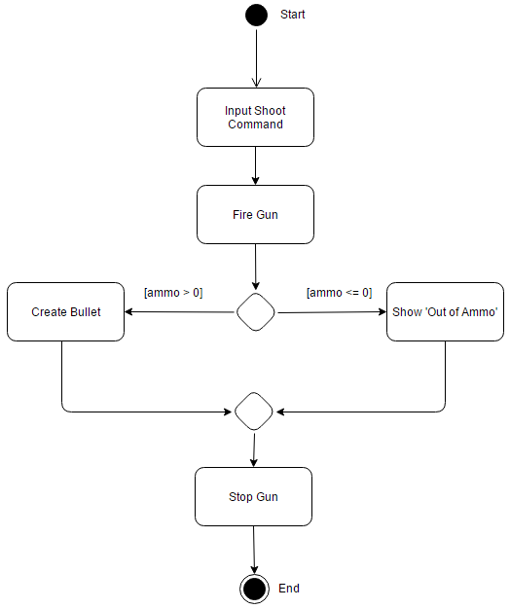
Activity Diagram Basics
These diagrams are used to provide a graphical view of a use case scenario
Conditional behaviour is shown by branches and merges
These are drawn as diamonds
The arrows between nodes indicates when the first action completes the second action begins

Slide 5
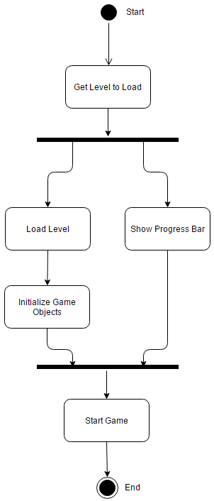
Concurrent Activities
A fork represents the separation of activities into two or more concurrent activates
Concurrent activities are typically implemented using threads, but could be activities performed on different computers
A fork is drawn as a black bar with one arrow pointing in, and two or more pointing out
Each output represents a flow of control to be executed concurrently
A join is a way of synchronizing concurrent flows
It is essentially the opposite of a fork

Slide 6
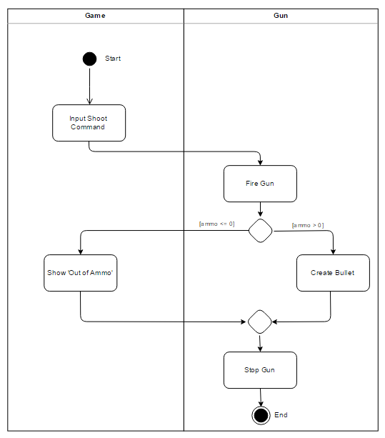
Swimlanes
One thing activity diagrams don’t show is who or what does each of the actions
Often though, the exact division of labour does not matter
If you need to show this information, decorate the diagram with swimlanes
The diagram is divided into lanes corresponding to each of the participants
All actions in a lane are done by the corresponding participant

Slide 7
When to Use Activity Diagrams
When you want to graphically show the flow of execution that occurs when performing a task
When you want to show concurrency
When you want to show both the basic course of action together with the alternative courses

Slide 8
Summary
Activity diagrams show the flow of control between actions performed in a system
They provide an intuitive graphical view of the system behaviour
Alternative paths can be shown using branches and merges
Concurrent activities can be shown using forks and joins

Slide 9
References
Sparx Systems. 2017. Activity Diagram. [ONLINE] Available at: http://www.sparxsystems.com.au/resources/uml2_tutorial/uml2_activitydiagram.html. [Accessed 13 April 2017]
Scott W. Ambler. 2017. UML 2 Activity Diagrams: An Agile Introduction. [ONLINE] Available at: http://www.agilemodeling.com/artifacts/activityDiagram.htm. [Accessed 13 April 2017]
Roger S. Pressman, 2014. Software Engineering: A Practitioner's Approach (Irwin Computer Science). 8 Edition. McGraw-Hill Education

